Slide 1
ParkMaster: An in–vehicle, edge–based video analytics service for detecting open parking spaces in Urban environments
Published: SEC 2017
Authors:
Victor Bahl (Microsoft Research),
Giulio Grassi, Giovanni Pau (Pierre and Marie Curie University),
Kyle Jamieson (Princeton University)
Presenter: Arjun Prakash

Slide 2

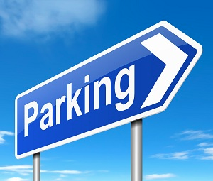
Motivations: the search for a parking spot
6.5 minutes to find a parking spot
(commercial district of San Francisco)
More traffic congestion
More pollution
Solutions available for large parking lot
[An Algorithm for Parking Lot Occupation Detection, CSIM 2008]
Few solution for on-the-road parking
[Parknet, MobiSys 2010]
[Caraoke, Sigcomm 2015]
[City of San Francisco, Sfpark project]
Expensive systems on the roads or in cars
Need of a cost-free system for on-the-road parking monitoring

Slide 3
Key Technologies
Image Processing
Has made significant Accuracy advancements
Has provided an array of research topics
Advanced Mobile devices
High Quality camera
Are capable of running image-based Machine Learning algorithms
Cloud services
Are available for implementing latency-critical applications out to the edge

Slide 4






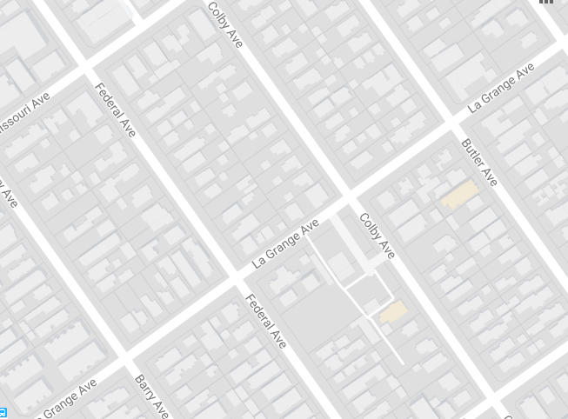
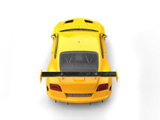
ParkMaster
CLOUD
?
3 PARKINGS
AVAILABLE
3 PARKINGS
AVAILABLE
2 PARKINGS
AVAILABLE
Notes:
Mobile Application on car edge detects location of detected vehicles and upload data to cloud
cloud service maintains real time database

Slide 5
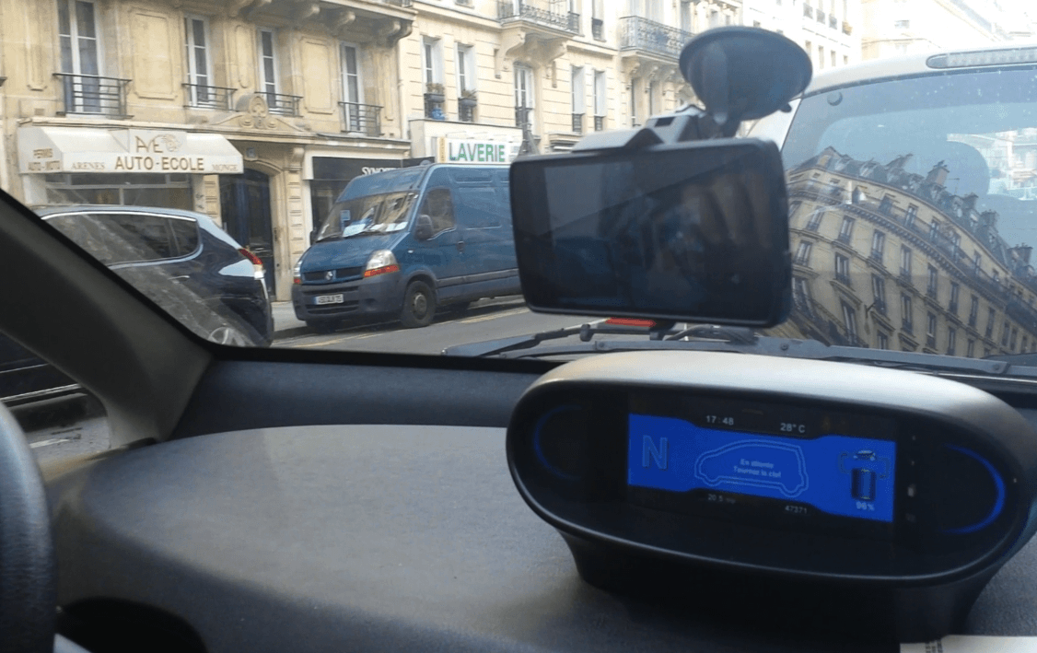
ParkMaster
Camera of driver’s smartphone as sensor for on-the-road parking availability
Contributions:
Close to zero-cost system for parking availability monitoring
Lightweight tracking algorithm
In-frame car localization algorithm

Slide 6
ParkMaster: Overview
Parked Car Detection and Counting
Difference between number of parked cars and total number of parking spots
Lower GPS requirements for accuracy
Total number of parking spots per road easier to get
In-cloud DB stores estimated parking availability

Slide 7
Challenges
Resource limitation
Concept to be applied in Real cities
Parking spot should be a legal one
Detailed maps with exact parking space coordinates.

Slide 8
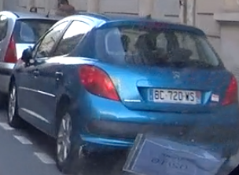
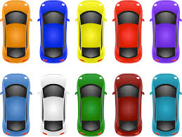
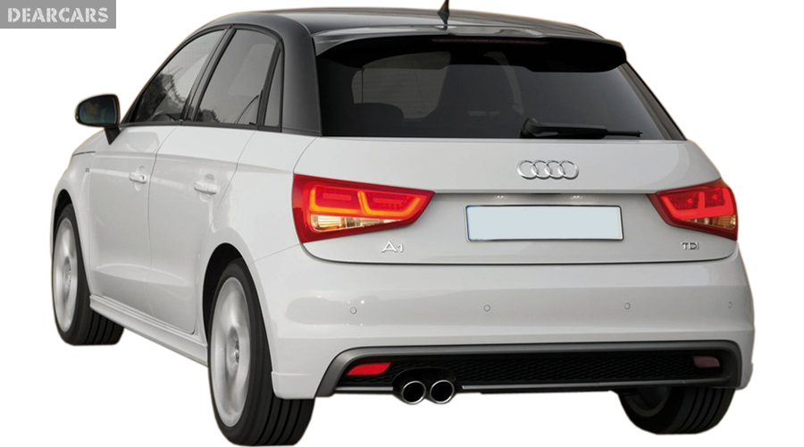

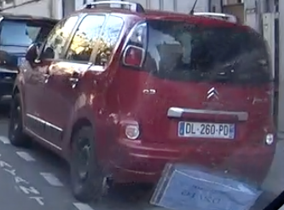
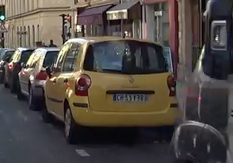
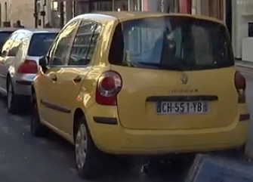
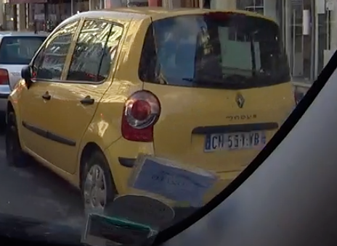
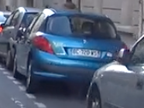
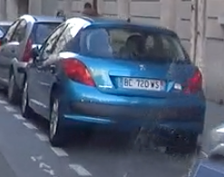
ParkMaster: Overview

Slide 9
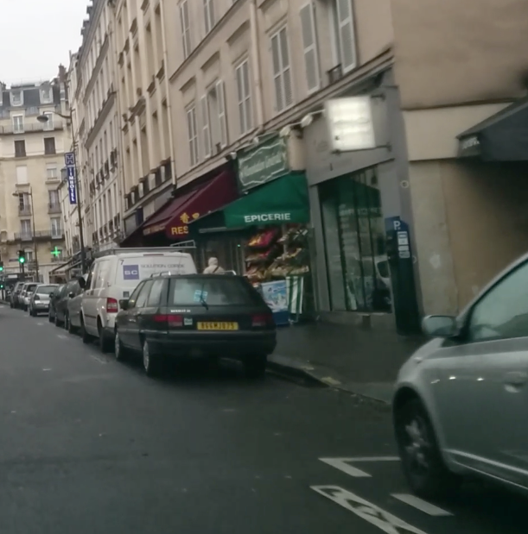
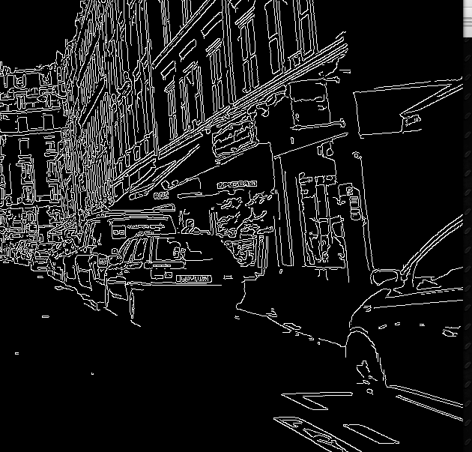
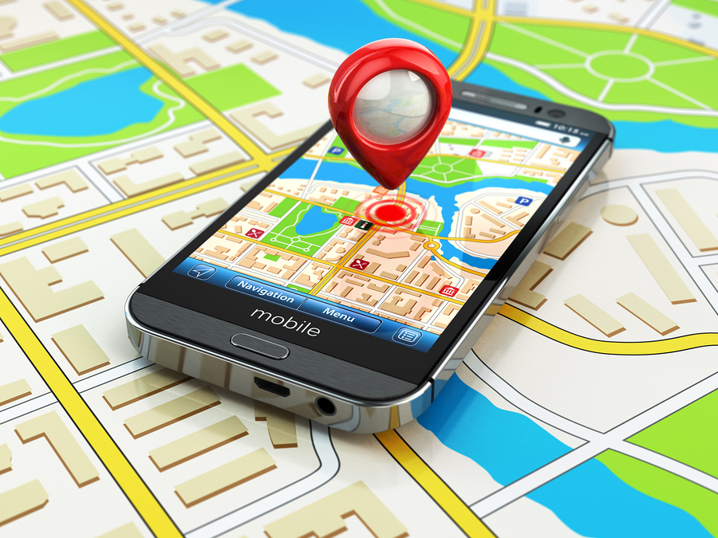


Empty Space Detection
Edge detection
Empty space ≠ Parking spot
An accurate map of each parking spot is needed to localize empty space
EMPTY SPACE
DETECTED!
Position: 48.8442, 2.3534
Position: 48.8452, 2.3544
Position: 48.8462, 2.3554
Position: 48.8472, 2.3564
Empty space detected!
Position: 48.8462, 2.3544
±10 meters

Slide 10
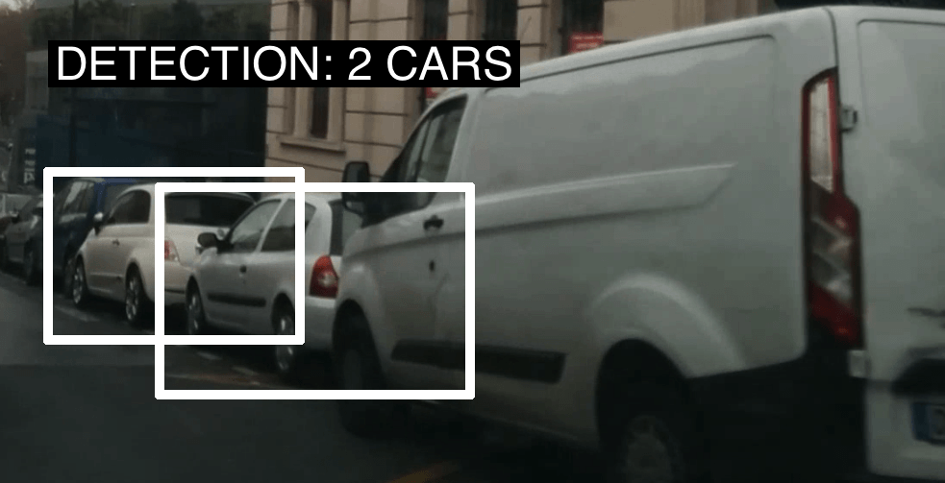
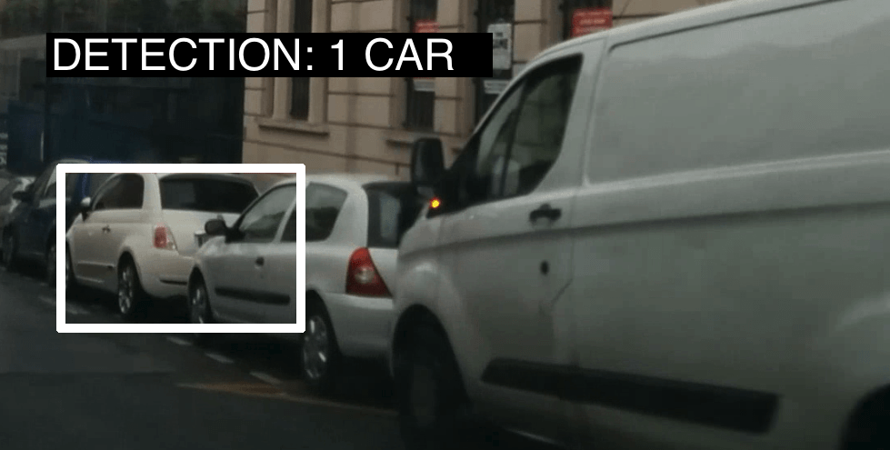
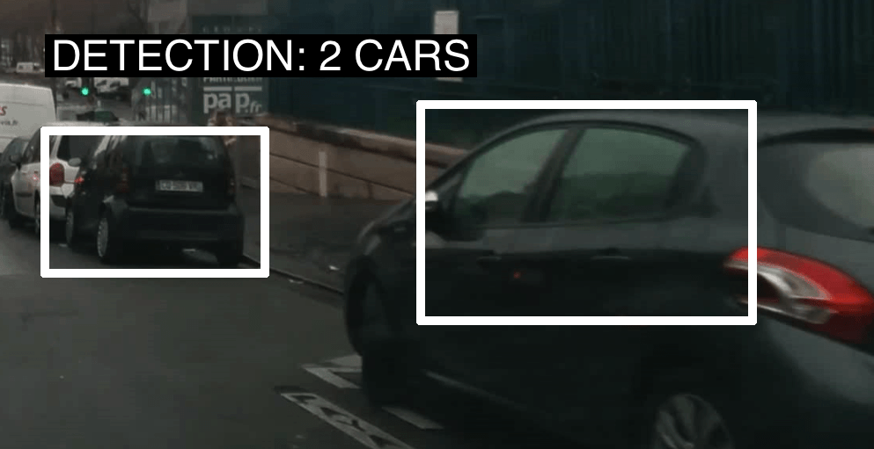
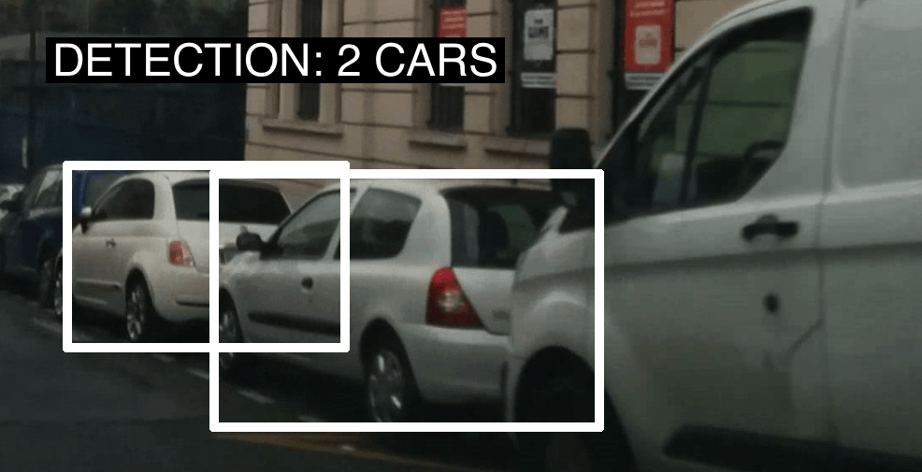
ParkMaster’s Cascade Classifier
Classifier is based on Viola-Jones
One-time offline training
On server
Extract vehicles main features
Training output used at run-time to detect cars
On the phone
Detection on smartphones: performance
5.78 fps (Galaxy S4)
10.44 fps (Galaxy S6)

Slide 11
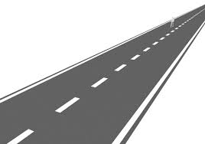

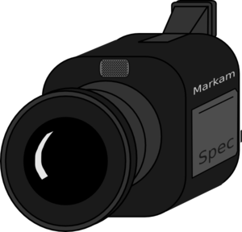
Calibration on-the-go
Translation from 2D frame system to 3D real world system
Camera calibration is needed
Intrinsic camera parameters
Focal length
Extrinsic camera parameters
Camera rotation and translation
2D
3D
v_{C} ,
u_{C}
X_{C} , Y_{C} , Z_{C}

Slide 12
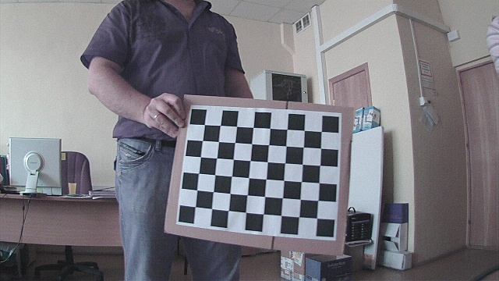
Calibration on-the-go
Classical calibration with well-known patterns
[An efficient Obstacle Awareness Application for Android Mobile Devices, ICCP 2014]
Not feasible
Needed every time the phone is placed on the dashboard
Automatic on-the-go calibration process
Beginning of a drive, road signs are detected
Well-know size and elevation from the ground

Slide 13
Car Localization
Translation from 2D frame system to 3D real world system
Given the camera parameters, at each point in the frame correspond multiple points in the 3D world.
We need to fix one of the axis in the 3D system
Assumptions: cars lay on the ground
2D
3D

Slide 14
Car counting
On the cloud
Clustering on coordinates set
DBSCAN
Heuristics to decrease the error
Camera-Vehicle distance
Cluster size: multiple detections
Cloud’s estimate always corresponds to the most recent drive on that road
Notes:
DBSCAN: Density Based Spatial Clustering of Applications with Noise

Slide 15
Implementation
The edge components
Android Smartphones
Samsung Galaxy S4 and S6, LG Nexus 5
OpenCV 2.4
Cascade Classifier trained with:
1,202 positive samples
719 negative samples
Available at www.github.com/grassig/parkmaster/
Cloud
Azure Mobile Service
MongoDB
Google Snap Road API

Slide 16
Evaluation
Notes:
We now move to the evaluation of ParkMaster

Slide 17
Experiments overview
Micro-benchmarks
Car detection accuracy and performance
Impact of processing power in car detection accuracy
Object localization accuracy
Full system
On-the-road experiments driving in 3 different cities

Slide 18
Experiments on the road
Place | Distance | Unique distance | Parking spots | Parked cars
EU-village (Sant’Angelo) | 17.9 Km | 3.3 Km | 1,381 | 710 cars
EU-City (Paris) | 38.4 | 7.9 | 3,527 | 2,892
USA-city (Los Angeles) | 41.0 | 19.3 | 3,268 | 2,294
Totals | 97.3 | 30.5 | 8,176 | 5,896

Slide 19
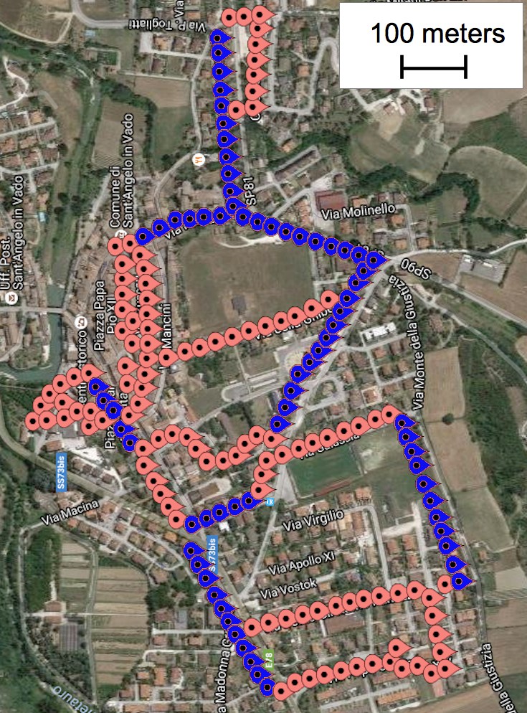

Village: Sant’Angelo in Vado
Italian village
No tall buildings
More space between cars
Distance driven: 17.9 KM
Parking spots: 1,381
Parked cars: 710
Red points: streets with parking space
Blue points: roads with no legal parking

Slide 20
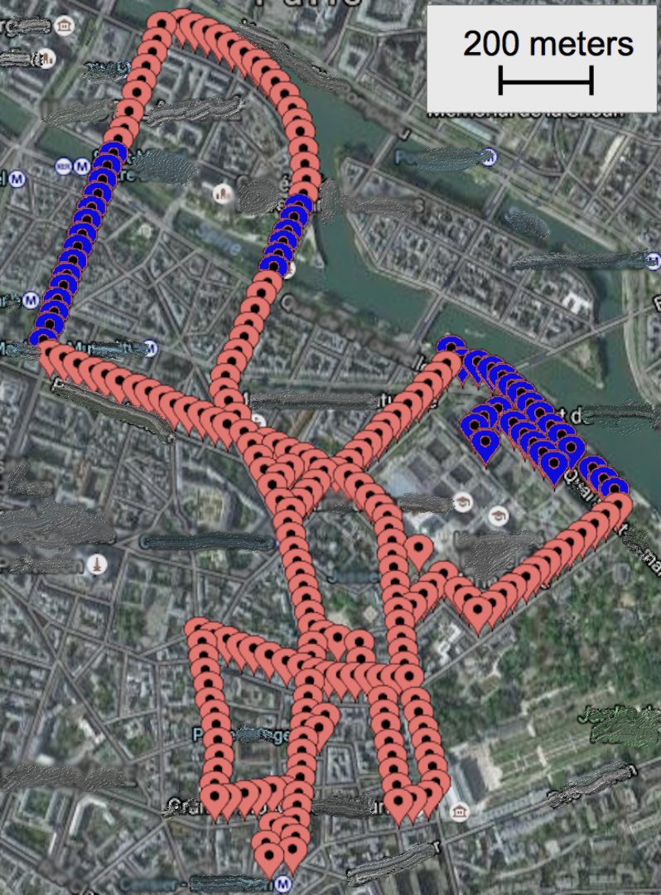
EU City: Paris
European City
Tall buildings
Short space between cars
Stop and go mobility
Distance driven: 38.4 KM
Parking spots: 3,527
Parked cars: 2,892
Red points: streets with parking space
Blue points: roads with no legal parking

Slide 21
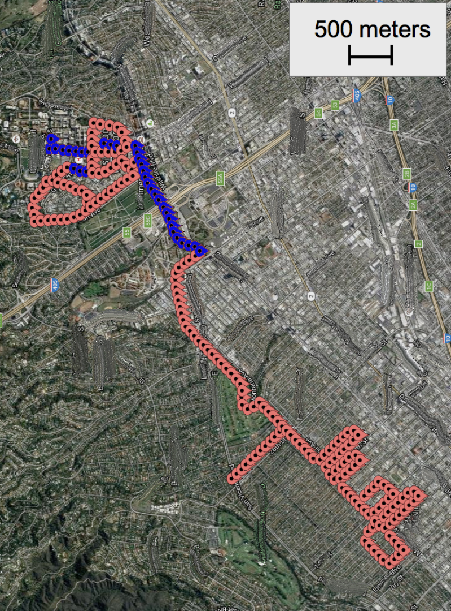
US City: Los Angeles
US City
Tall buildings
Some space between cars
Stop and go mobility
Distance driven: 41.0 KM
Parking spots: 3,268
Parked cars: 2,294
Red points: streets with parking space
Blue points: roads with no legal parking

Slide 22
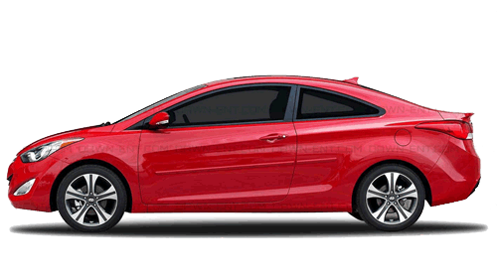
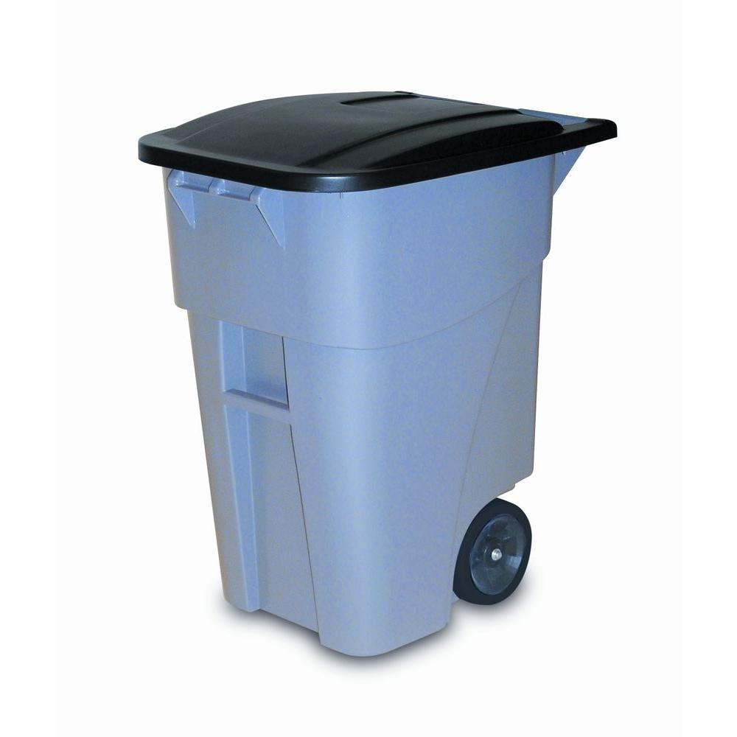
Evaluation Metrics
True positives
False positives

Slide 23
Evaluation Metrics
Car counting accuracy
Missed
ParkMaster: 5 cars
Ground Truth: 4 cars
23
Notes:
Error: parked cars – parked cars counted

Slide 24
ParkMaster: Overall accuracy
Notes:
Park Master shows better performance in rural environment as compared to urban environment. (larger distance, better localization)

Slide 25
Users’ perspective
Is there at least a parking spot on the road?
True Positive
True Negative
ParkMaster: Yes, there is at least a spot available
ParkMaster: No, road is full

Slide 26
Parking Availability

Slide 27
Causes of error
Place | Classifier | Bounding Box | GPS | Localization | False Positive
EU-city (Paris) | 24.3% | 29.2% | 26.3% | 8.0% | 12.2%
EU-village (Sant Angelo) | 29.6 | 29.8 | 14.4 | 7.0 | 19.2
USA-city (Los Angeles) | 24.5 | 27.8 | 25.1 | 17.1 | 5.6
Improvements:
Computing power at the edge
Classifier
Phone’s localization

Slide 28
Data Usage
Edge – Cloud traffic:
GPS coordinates (Google Snap-to-Road API)
Parking analytics
67 bytes per detection
8 hours driving
6.1 Megabytes
Cloud-based solution: 4.8 Gigabytes

Slide 29
Conclusions
Close-to-zero cost system for parking availability
90% Accuracy in 2 different metropolis and 1 small village
Position-based tracking system that cope with computing limitations of the edge
Vision-based urban environment monitoring at the edge possible with current technology

Slide 30

Questions?
Thank you for your attention.
Questions?

